Slide 1
Machine Learning Methodology of Unobtrusive Sleep Monitoring
ENORA Innovation
6th ALAMEDA Meeting, Thessaloniki, 29-30/06/2023
George Koutalieris, ENORA Innovation
Harris Georgiou , ENORA Innovation
Paraskevi Rapti, ENORA Innovation

Slide 2
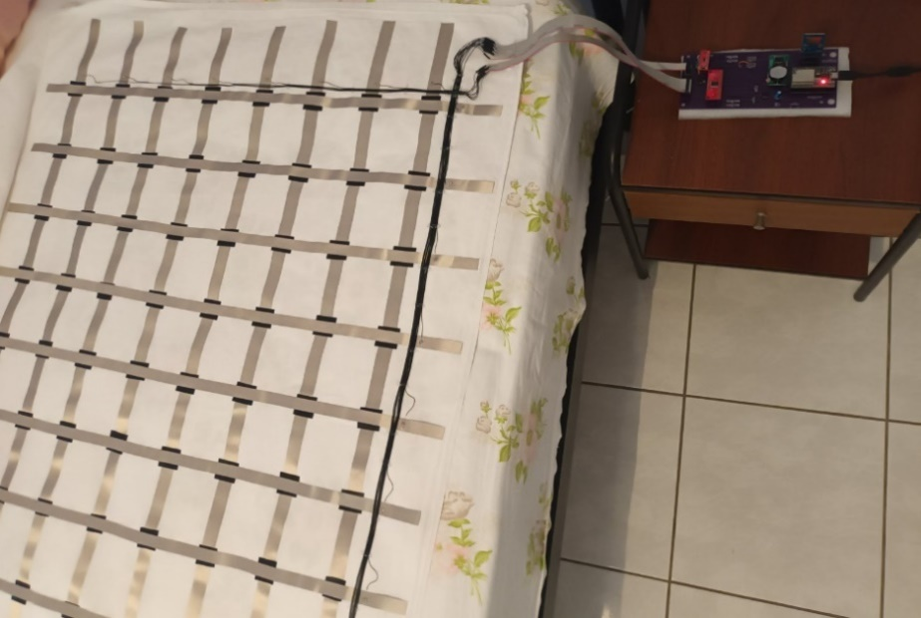
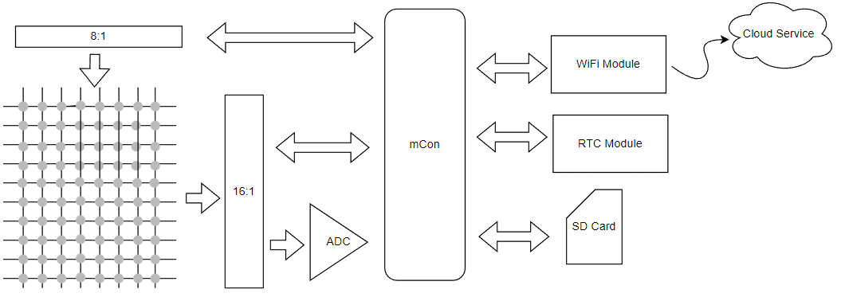
Enora Mattress Topper Prototype
A prototype device that acquires pressure points of the human body while sleeping.
Pressure element is based on Velostat plastic film
Sensing current less than 10mA, at 5V.
Top area insulated (image without insulation)
The local SD contains settings (keys, WiFi, time)
The mCon performs a raster scan every 1 minute
All points are stored in local SD and posted via the WiFi module to the Enora Cloud

Slide 3

System Integration IaM – SemKG 1/2
Withings Data
SemKG
Pressure Data*
Precesseed Data (where applicable Withings and Pressure data)
Combined with IAM patient Key, based on existing settings.
Enora DB
* Prototype in Athens Sleep Clinic

Slide 4
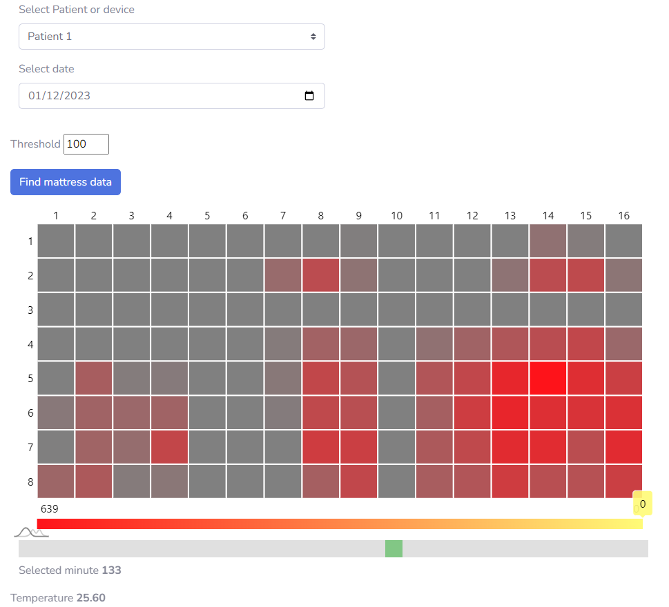
Posture detection from raw pressure data
Raw data acquired every 1 minute
Predefined set of possible positions are matched to new dataset.
Posture results:
Type of posture
Duration of posture
Rate of change of posture
13k of records so far
Create histogram to present sleep posture changes over time

Slide 5
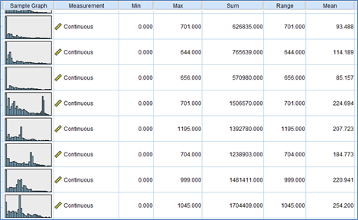
Data specifications
29 distinct measurement sessions, corresponding to distinct patients and their sleeping sessions,
Each containing a variable number of records (min=20, max=636, mean=239).
The sampling scheme is synchronous with sampling rate between 135...209 sec.
Sample statistics of the second row of sensors (2,*) across all the sessions.

Slide 6
Data filtering considerations
Some noise filtering is usually applied on the raw data.
However, in this case this was not implemented for two reasons:
Without specific annotation from domain experts, applying such a filtering process “blindly” may remove useful discriminating information for the task at hand;
We employed spectral decomposition using only the most significant spectral components for further processing
This approach essentially “ignores” factors of limited energy, including noise.

Slide 7
Rationale and pipeline design
Design a proper data pre-processing and feature extraction pipeline.
Identify possible similarities / dissimilarities in the data (patterns).
Propose a set of baseline / “normal” and outliers / “abnormal” conditions.
The optimal design decisions specifically for the task of mobility patterns during sleeping sessions can be summarized as follows:
The original dataset was assessed and validated removing only one erroneous session (3 records) and applying no noise filtering.
Spectral decomposition was selected for noise removal, as well as for the per-session and all-session data pre-processing.
The temporal dimension is reduced either by statistical aggregation functions (first-order statistics) or spectral decomposition.
Per-session analysis is also aggregated to all-sessions analysis as needed, in order to reduce the effects of having several sessions of widely varying sizes, as well as producing a better baseline / “normal” reference across all sleeping sessions.

Slide 8
Sleep data aggregation
The sleep data from multiple sessions are combined and analyzed collectively.
This approach mitigates the effects of session duration differences and enables the creation of a more comprehensive and representative reference for what is considered "normal" across all sleeping sessions.
By aggregating the data, the approach provides a broader perspective on sleep positions and patterns, accounting for a larger dataset.
This can improve the accuracy of identifying and categorizing different sleep positions and establishing more reliable baselines for normal sleep behaviors.
The aggregated analysis allows doctors and researchers to gain insights into sleep position distributions, variations, and potential abnormalities across multiple sessions.
Doctors can better evaluate sleep patterns, assess patient sleep quality, and potentially identify any deviations or issues that may be impacting overall sleep health.

Slide 9
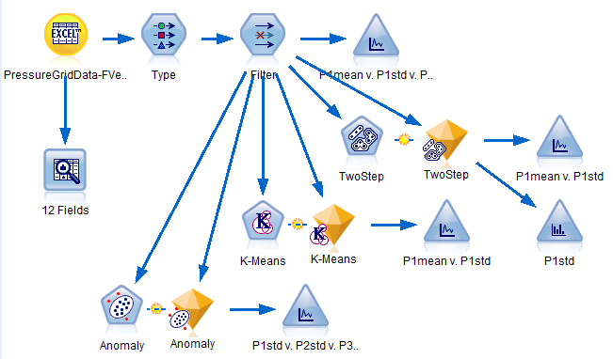
Per-session pipeline
Sample pipeline for the per-session statistically aggregated dataset, including unsupervised Machine Learning models and visual analytics tools

Slide 10
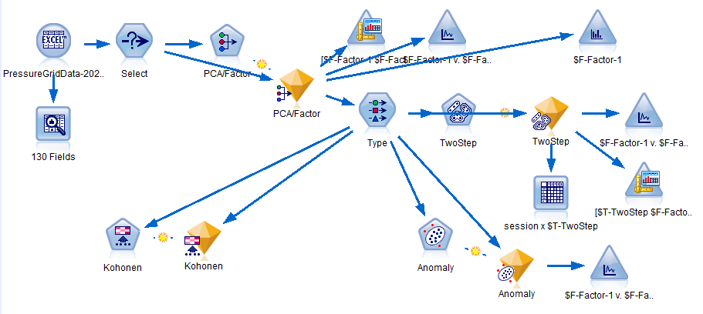
All session pipeline
Sample pipeline for the all-session pipeline based on spectral decomposition aggregated dataset, including some learning models and visual analytics tools

Slide 11
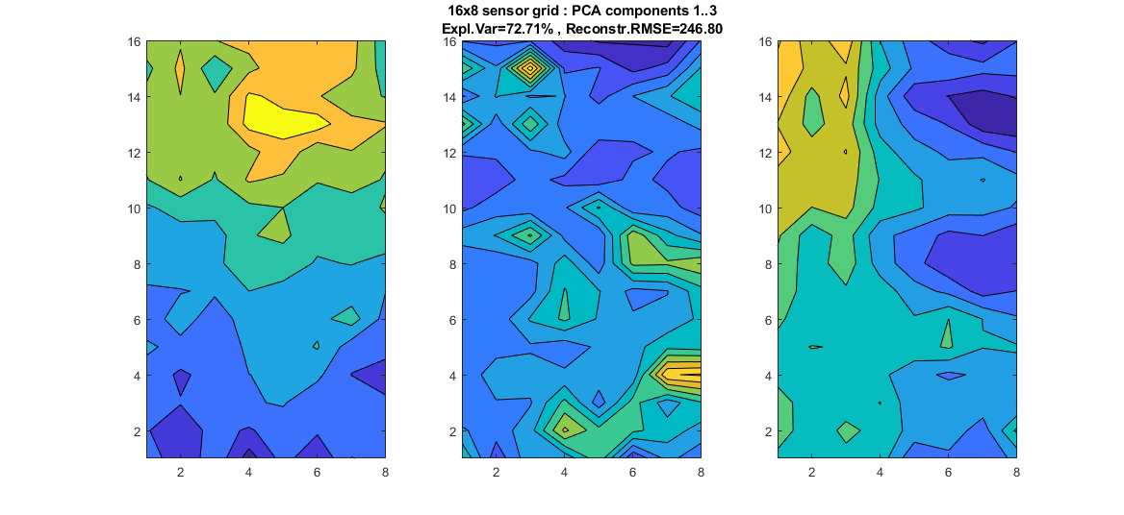
PCA spectral decomposition
The PCA spectral decomposition provides insights at the main mobility patterns that can be considered as stances or “states”

Slide 12
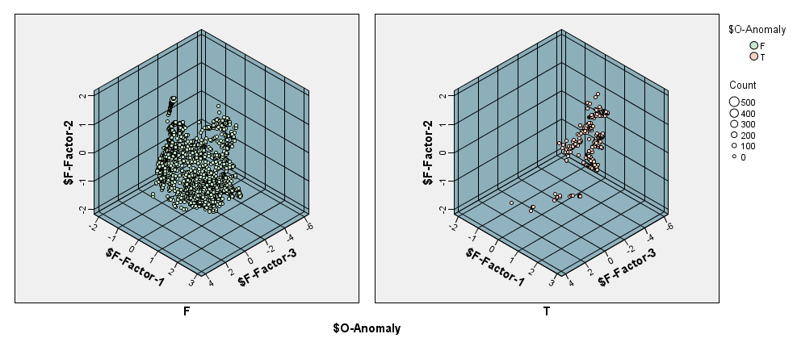
Decoupling normal and outlier clusters
Distribution of data samples in “normal” (left) and “anomaly” (right) clusters (decoupled) of the PCA loadings components using TwoStep clustering model

Slide 13
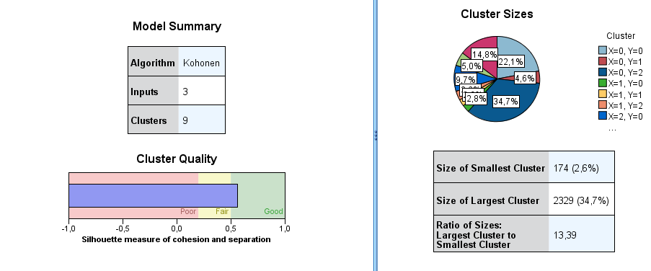
Understanding variability using Kohonen clustering
Kohonen clustering is used to analyze and understand the data collected from the sensors in a more detailed way.
A self-organizing neural network of size 3-by-3 was designed for clustering the data samples into a total of nine possible labels.
This method helps us understand the variability in sleep positions and can be used to calculate a variability index.

Slide 14
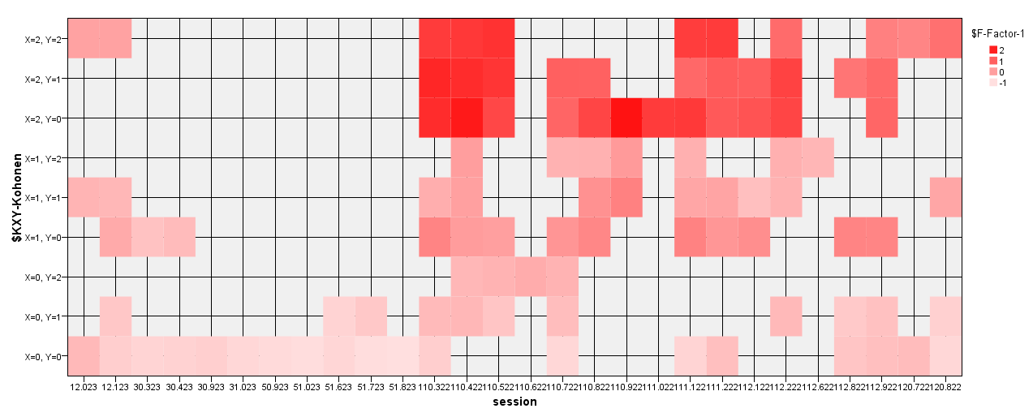
Understanding variability using Kohonen clustering
Distribution of (normalized) PCA loadings for component 1 w.r.t. sessions and clusters for the optimal Kohonen clustering.

Slide 15
Unsupervised learning approach
PCA spectral decomposition helps to identify the main patterns of movement that the person goes through while sleeping.
The PCA spectral decomposition is a way to process this Mattress Topper data and find the most important patterns or trends within it.
Can be further enhanced by employing:
Independent Component Analysis (ICA) enforcing strict statistical independency for the spectral components.
Dictionary Learning / sparse modeling instead of ICA or PCA, enforcing further constraints to the spectral components:
specifically, low-rank representations of the raw measurements,
encoding it to a small set of well-defined unknown components or even a semi-defined “dictionary” based on specific requirements / designs from the properties of specific disorders to be detected (e.g. “wide” versus “compact” sleeping positions as core states).

Slide 16
The need for supervised learning
The active role of domain experts and their assessment is of paramount importance.
The analysis and the experimental work performed is designed around a purely unsupervised learning task.
This may limit the level of quality assessment and explainability of these models.
they depend almost entirely on statistical or other similar quality metrics.
the empirical feedback from experts will enable the use of target labels as ground truth,
not only for characterizing the clusters but, primarily, to open up the options of designing supervised learning models and transforming the core task into a classification and/or regression task.

Slide 17
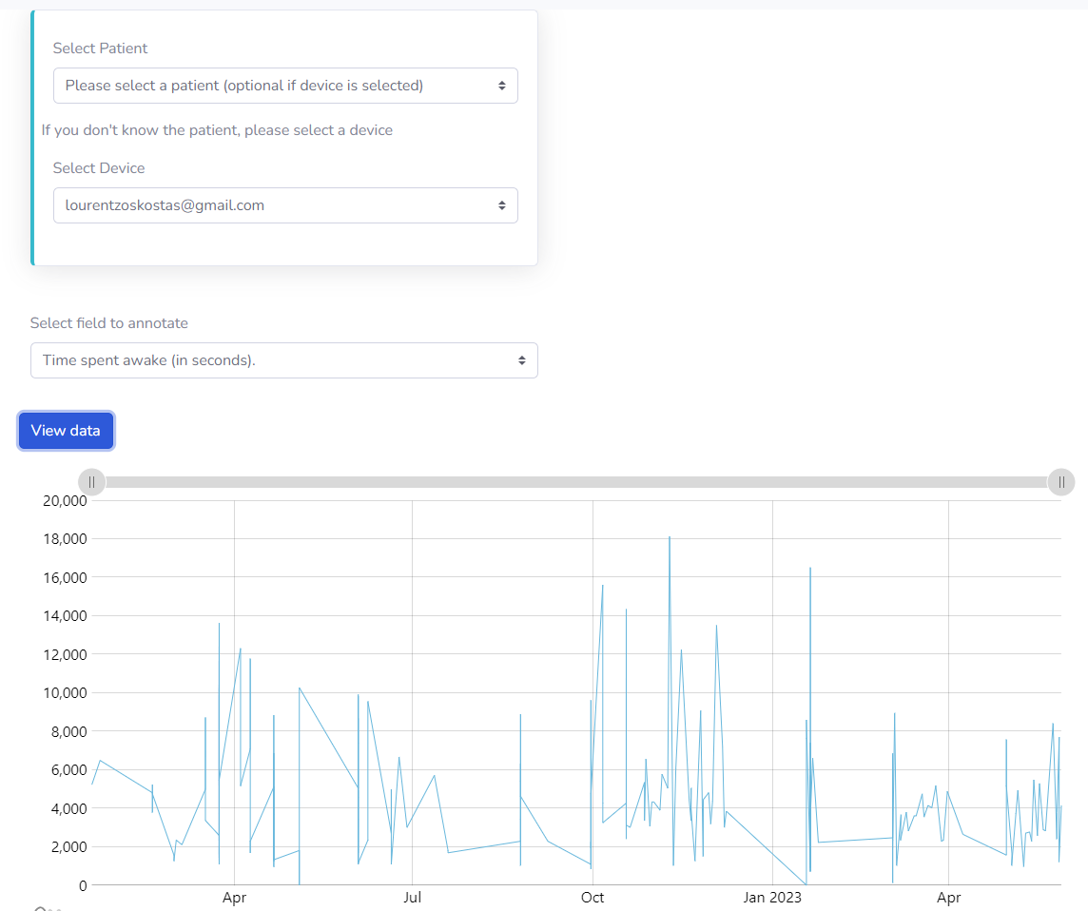
Annotation Tool UI
The user selects patient or device.
Patients and devices need to be registered at IAM.
Withings offers a variety of sensors, the user selects one to annotate.

Slide 18
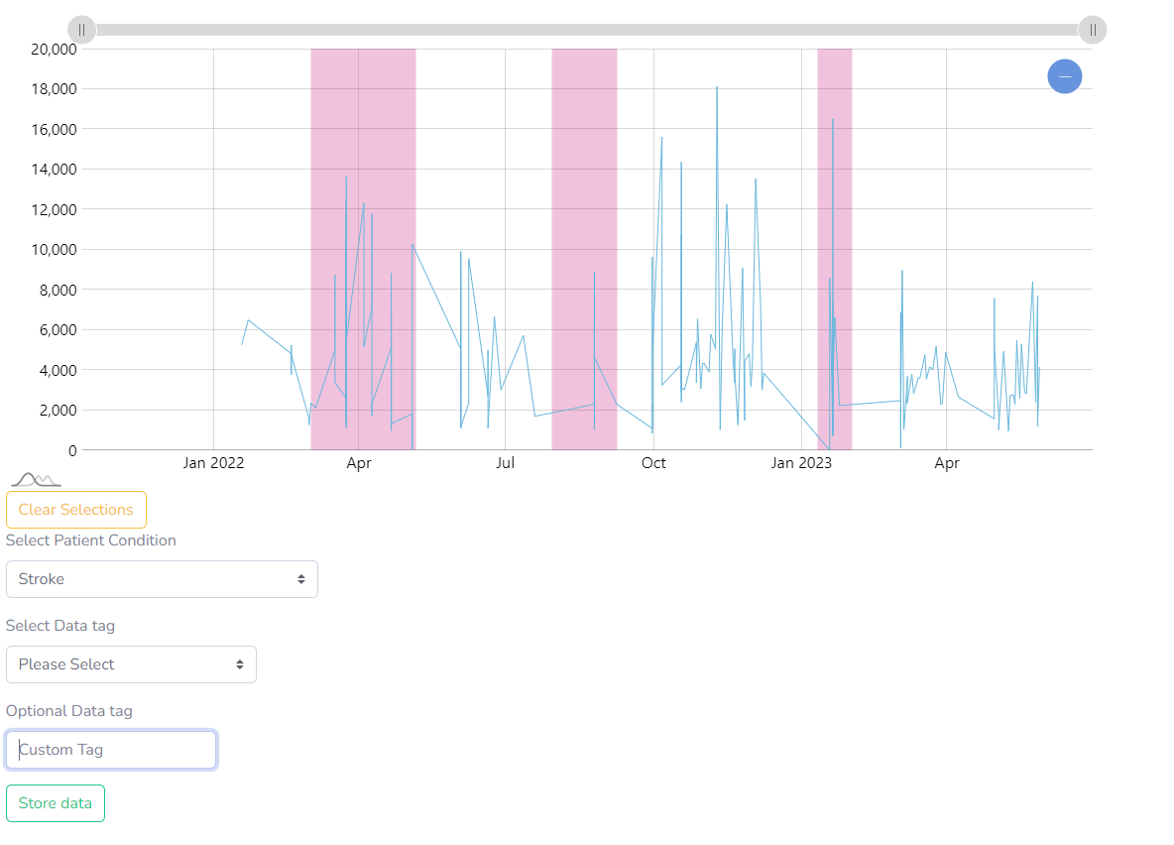
Annotation Tool
By just selecting the area, patient condition and a tag or add an optional tag the user can annotate the data selected.
This will allow the assessment tool to run and visualize in a spectrum graph the sleep results.

Slide 19
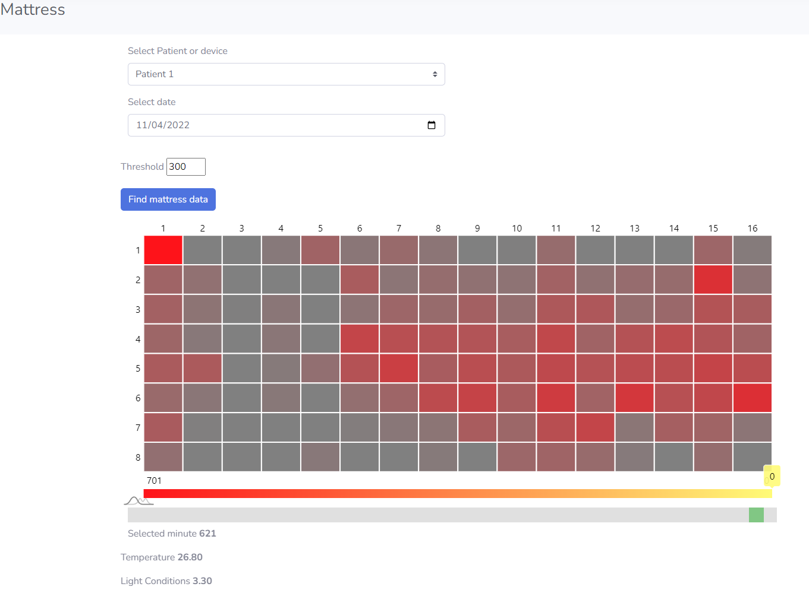
Sleep Assessment / Position

Slide 20
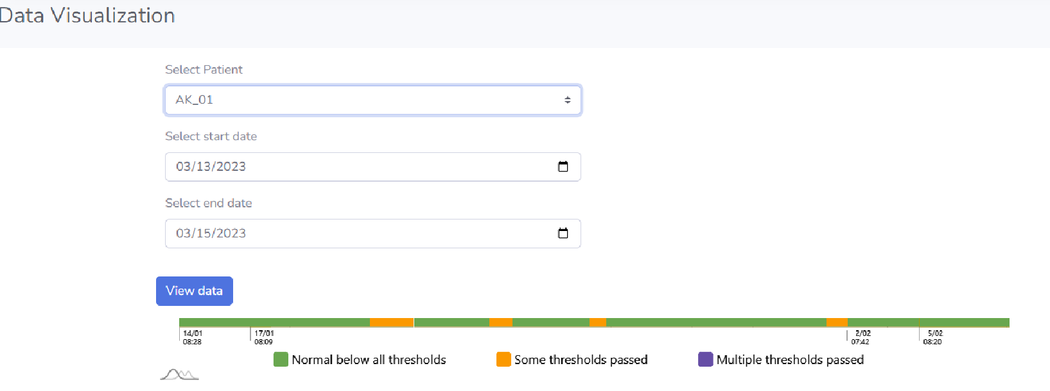
Annotation Tool
Once the data are annotated, a process runs to view the resulting assessment.
For this to work, we have requested nights with data of non-patients (normal baseline).

Slide 21
Thank you

